Slide 1


AI Employees,
Not AI Tools
Pre-Seed 2026
Persistent AI employees that run your content business. They research, produce, and improve every cycle.
yarnnn.com · Kevin Kim · kvkthecreator@gmail.com

Slide 2
The industry is bifurcating.
The AI agent wave is here. OpenClaw: 307K GitHub stars in 60 days. Claude shipped Cowork. Cursor has a million daily users. Massive demand for AI that does real work.
But every product in this wave is a tool. Session-scoped. User-present. Stateless between runs. Running a content business requires something structurally different.
But every platform cycle looks that way — until it doesn't.
Google didn't become Salesforce.
Facebook didn't become Shopify.
AWS didn't become Datadog.

Slide 3
The Landscape
Three approaches to AI agents. Only one builds employees.
OpenClaw
|
307K stars. Open-source. Session-scoped — resets every time. No scheduling, no memory.
Claude Cowork
|
Anthropic desktop agent. Powerful in-session. No persistence, no autonomy.
yarnnn
|
Cloud-native AI employees. Persistent. Autonomous. Cross-platform. Run your content business — never reset.
The difference
|
Tools reset every session. Employees accumulate over months. The gap is structural.
OpenClaw and Cowork validate massive demand for AI that does real work. But tools reset. yarnnn is the only product where work compounds into a content business.

Slide 4
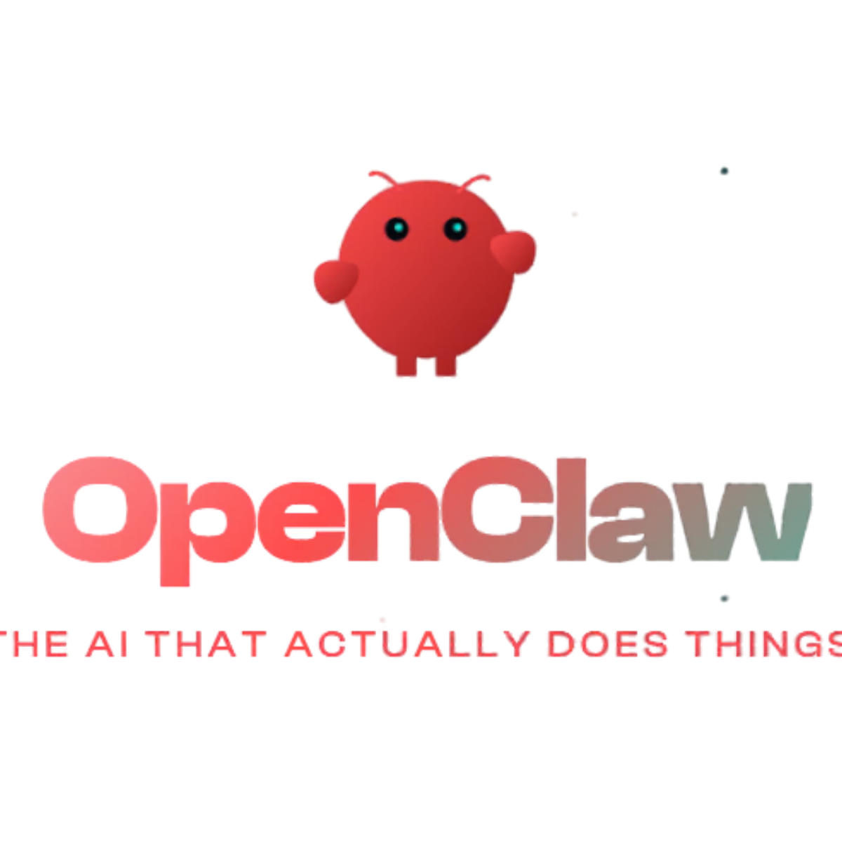
The Product
What your AI employees do that tools can’t.
1 Work autonomously
Run on schedule — nights, weekends, holidays. Recurring deliverables arrive on time, every time.
2 Accumulate expertise
Every run deepens domain knowledge. Every edit teaches preferences. 90 days of tenure is irreplaceable.
3 Perceive across platforms
Slack, Notion, GitHub syncing continuously. Cross-platform awareness no single tool has.
4 Coordinate as a team
10-agent roster + task pipeline. Autonomous execution, not solo prompting.
5 Produce subscriber-ready content
Newsletters, reports, data products. Not chat responses — revenue-generating content.
This is the employee layer. Not a better chatbot — an autonomous team that runs your content business.

Slide 5
Product
Architecture
Solution / Moat

Slide 6
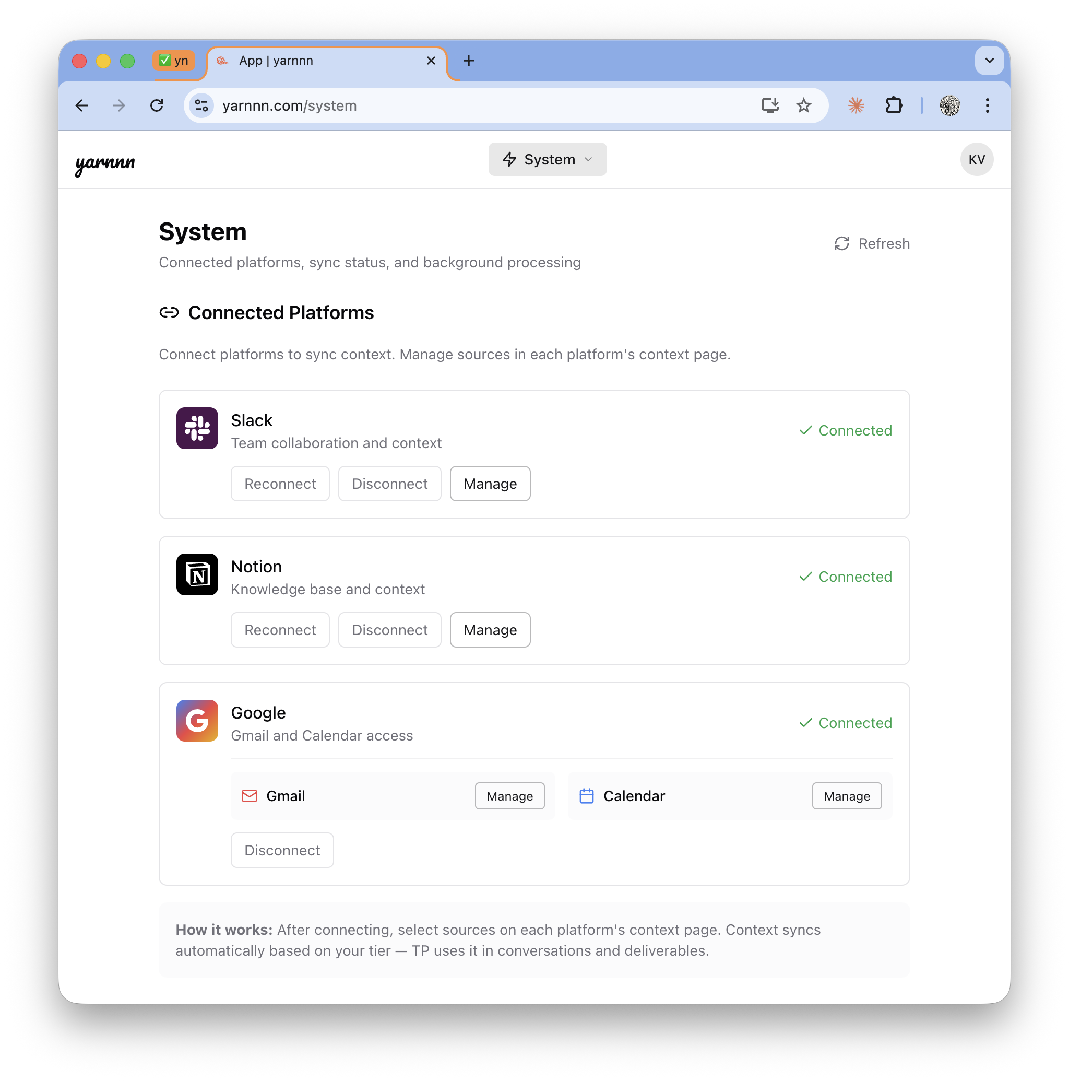
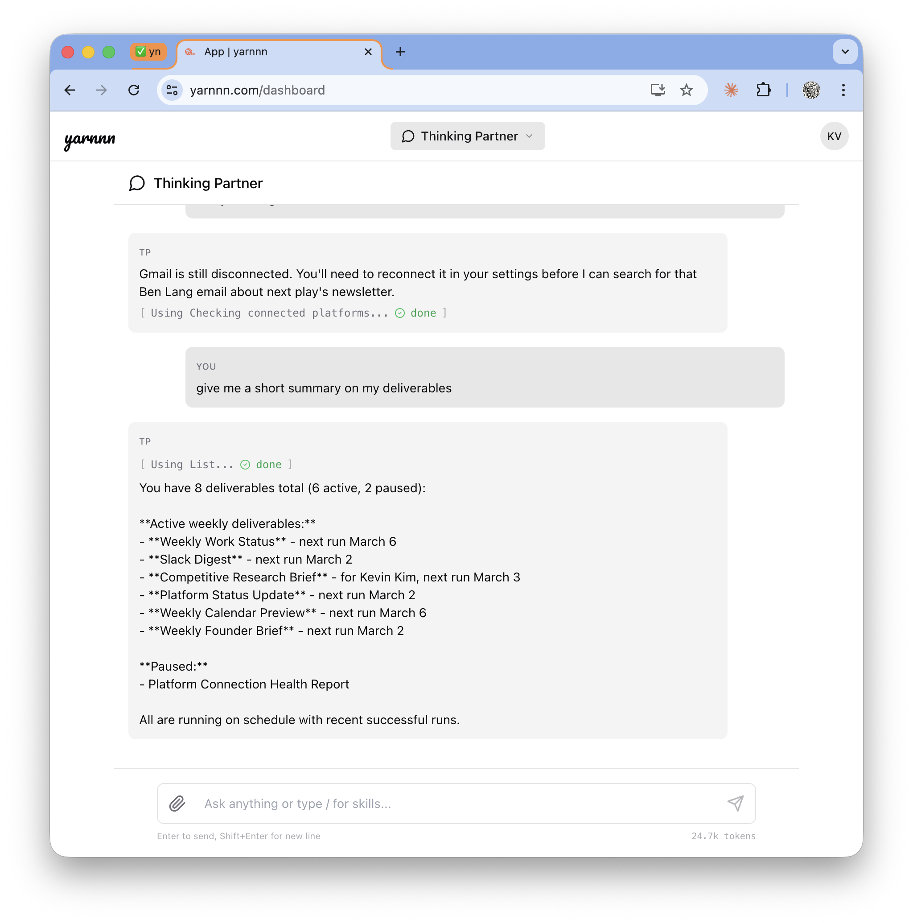
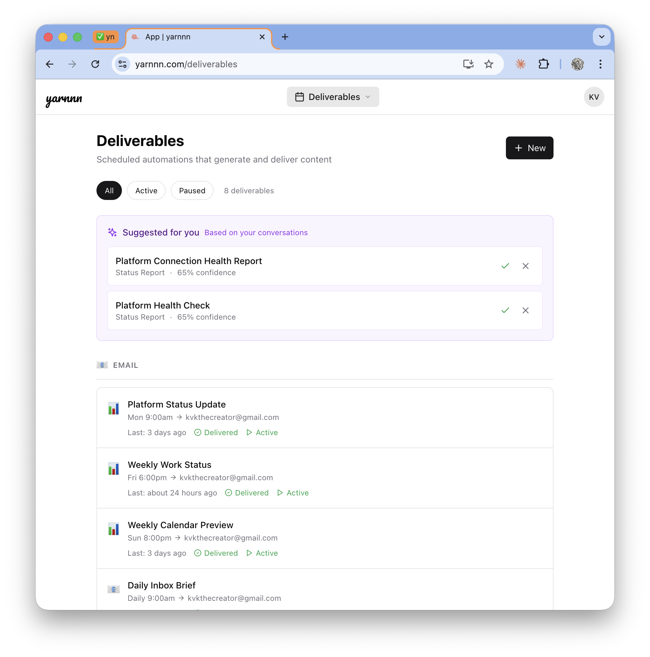
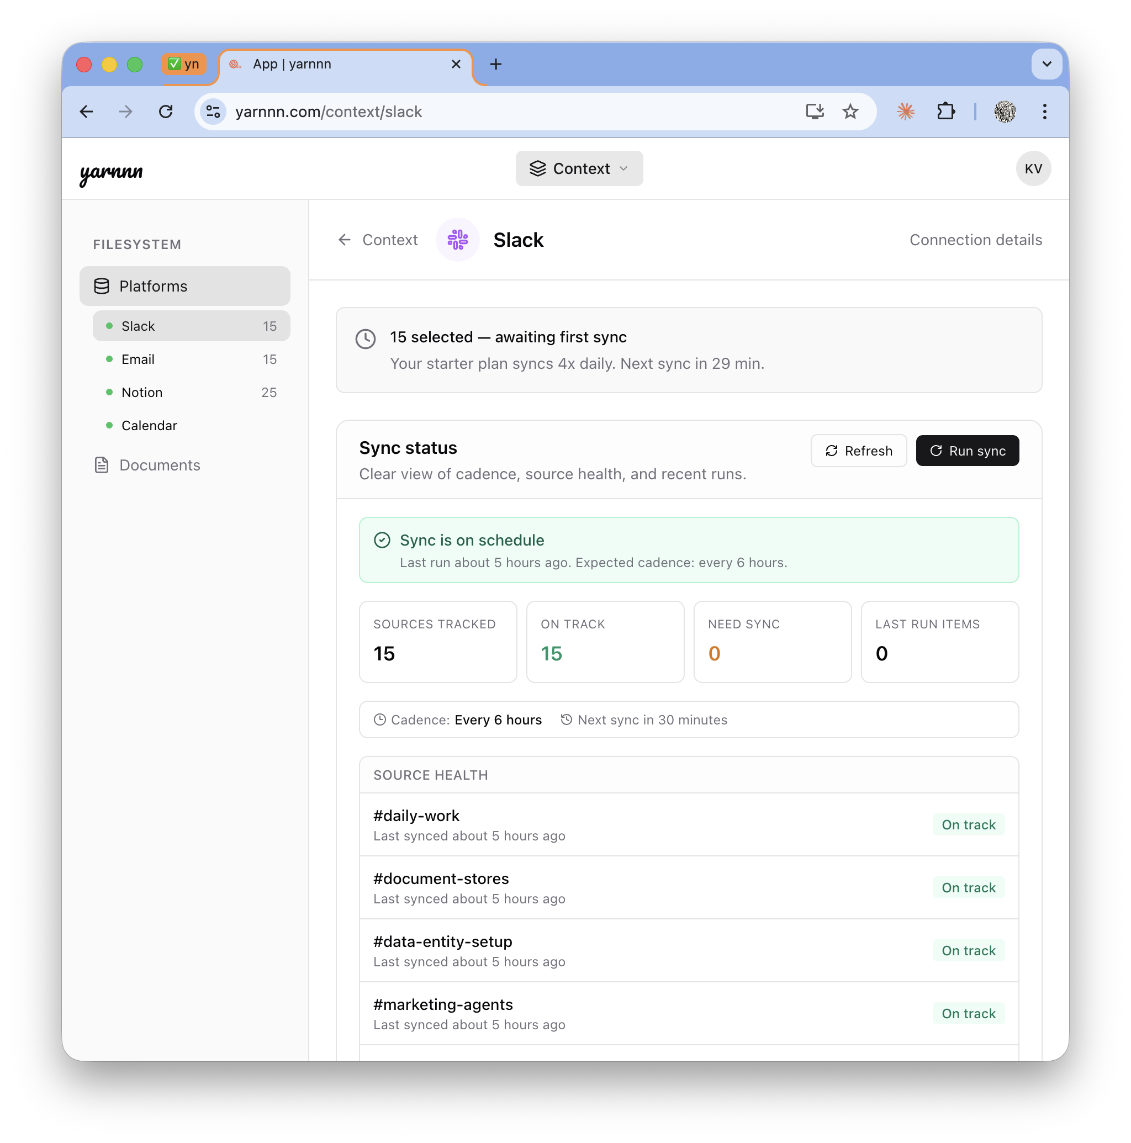
Product: Meet Your AI Employees
Pre-built workforce. Ready on day 1.
T+0s
T+30s
Days
Weeks
Dump, Connect
Team Ready
Accumulate
Compound
Describe your work. Your AI employees are pre-built and ready.
Tasks assigned to the right specialist. Context loading begins.
Every sync deepens knowledge. Every edit refines quality. Teams coordinate.
Quality visibly improves. Content finds its audience. Switching cost crystallizes.

Slide 7
How Your Employees Work
The infrastructure behind autonomous employees
Five systems that work together. Each one compounds with tenure.
Platforms
+ MCP
Context
Domains
Workspace
Filesystem
Agent
Workforce
Output
Gateway
Slack
Notion · GitHub
Workspace filesystem
Accumulated intelligence
AGENT.md + TASK.md
Inference + memory
10-agent roster
Task pipeline + compose
HTML compose
PDF · PPTX · XLSX
Why tools can't replicate this:
AI Tools (OpenClaw, Cowork, Claude Code)
Agent Memory Startups (Mem.ai, Granola)
Workspace AI (Notion AI, Gemini)
Session-scoped. User must be present. Context resets between runs. No autonomous execution.
Memory without execution. Recall facts but don’t produce autonomous work products.
Single-platform. No cross-platform synthesis. No cross-LLM continuity.

Slide 8
Product
What your employees deliver.
Content products your AI team produces. Each has a defined pipeline, cadence, and quality contract.
Category
Deliverable
Pipeline (agents)
Default cadence
RESEARCH
Competitive Intel Brief
Research → Content
Weekly
Market Research Report
Research → Content
Monthly
Industry Signal Monitor
Marketing → Research
Weekly
BUSINESS OPS
Meeting Prep Brief
CRM → Research
On-demand
Stakeholder Update
Research → Content
Monthly
Project Status Report
Slack → CRM → Content
Weekly
PLATFORMS
Slack Recap
Slack Bot
Daily
Notion Sync Report
Notion Bot
Weekly
PRODUCTION
Content Brief / Blog Draft
Research → Content
On-demand
Launch Material
Marketing → Content
On-demand
TRACKING
GTM Tracker
Marketing → Content
Weekly
You describe the work. Your employees figure out the team, the handoffs, and the schedule. Deterministic cost, no ad-hoc prompting.

Slide 9
Product
Your team. Ten agents, six specialist roles.
Universal specialists assigned by work demand. Persistent memory. Learned preferences.
Researcher
Analyst
Writer
Tracker
Deep research with web search. Finds context beyond your connected platforms.
Cross-references sources. Surfaces patterns and insights across platforms.
Polished final output. Newsletters, reports, memos that ship as subscriber-ready content.
Monitors changes and signals. Tracks competitors, markets, and domain entities over time.
Designer
Reporting
Platform Bots
Thinking Partner
Charts, diagrams, and visual assets. Production-phase capabilities via render service.
Synthesizes across agents. Composes cross-domain intelligence into unified deliverables.
Slack, Notion, GitHub. Temporal context from connected platforms.
Your orchestrator. Creates tasks, evaluates quality, coordinates the team.
Thinking Partner
Meta-cognitive agent. Back-office hygiene, workspace cleanup, and strategic judgment.
One per workspace.

Slide 10
Product
How Employees Onboard and Grow
Like real employees — they learn your business, then produce. And they get better every week.
Context
Inference
Task Type Selection
Pipeline Execution
Autonomous Delivery
Connect Slack, Notion, GitHub. Context domains accumulate over time.
▶
System reads your work. Extracts identity, brand, scopes from docs + chat.
▶
Pick deliverables from the catalog. Each has a pre-built pipeline.
▶
Task pipeline runs on schedule. Compose substrate assembles structured output.
▶
Output compounds weekly. Feedback refines agents. Quality improves with use.
What makes this an employee, not a tool:
Job descriptions, not ad-hoc prompts
Transparent, editable work product
Tenure creates irreplaceable value
Every task has a defined execution plan. Employees run on schedule, metered transparently. No prompting required.
TASK.md + AGENT.md define everything. No hidden state. You can read and edit the same files your employees use.
Tools reset every session. Employees accumulate expertise. Every run deepens knowledge. 90 days of tenure is irreplaceable.

Slide 11
Solution: Moat
Revenue Regression Proves the Moat.
Switch to ChatGPT + Beehiiv and content quality drops. Revenue follows. Six months of accumulated team intelligence can't be replicated.
Three moat mechanics:
Describe
1
Accumulation: Every cycle deepens domain knowledge. Research sharpens. Production aligns with audience. Quality compounds measurably.
Compounding
Team
Intelligence
2
Cross-LLM Hub: MCP context hub: any LLM the user connects reads the same accumulated intelligence. The workspace becomes the single source of truth across tools.
Supervise
Accumulate
3
Revenue Regression: Content revenue regresses when accumulated intelligence is lost. Domain knowledge, audience preferences, production cadence — none transfer to a new tool.
Coordinate

Slide 12
Positioning • Market •
Competitive Landscape

Slide 13
Positioning
Tools vs. Employees. Two structurally different categories.
The local-first wave proves demand. yarnnn is where tool users graduate when they need work to run without them.
Autonomy
 | yarnnn | AI Tools (OpenClaw, Claude Code, Cowork) ChatGPT + Memory /Claude | Memory Startups (Mem.ai, Granola) Mem.ai, Genspark | Workspace AI (Notion, Gemini) Notion, Slack
Persistent agent identity | ✓ | ✘ | ✘ | ✘
Autonomous scheduled execution | ✓ Evolving | ✘ | ✘ | Single
Cross-platform accumulation | ✓ | ✘ | ✘ | ✘
Feedback compounds quality | ✓ Scheduled | ✘ | ✓ | ✘
Multi-agent coordination | ✓ Accumulation | Evolving | ✘ | ✘
Cloud-native (runs without user) | ✓ | ✘ | ✘ | ✘
yarnnn
ChatGPT + Memory
Claude Cowork /
Genspark
Knowledge
Accumulation
Existing
Workspace AI (Notion, Gemini)
Agent-based
Startups

Slide 14
Market
Starting with content product operators. Expanding from there.
Entry wedge: Domain experts who direct content, AI employees who produce it
TAM
SAM
Entry SOM
$4.35B
$1.14B
$4.6M
Creator economy + AI productivity tools (31% CAGR)
~5M content creators globally × $228/yr (Pro annual)
20K consultants in first 3 years
Expansion path:
Now
Content creators graduating from AI tools
Newsletters, data products, recurring content
Next
Consultants & analysts
Client reports, market briefs, strategic content
Then
Teams & ops leads
Standups, project reports, cross-team synthesis
Scale
All knowledge workers &#x2014; anyone hiring AI employees instead of operating AI tools
Any professional with recurring work obligations

Slide 15
Pricing Model
Usage-first billing. Balance is the single gate.
Free
Pro
Enterprise
$0
$19
TBD
/mo
/mo
/mo
· $3 signup balance included
· $20/mo balance auto-refills
· Everything in Pro
· All platforms + tasks unlocked
· All platforms + tasks unlocked
· Team workspaces
· ~40 chat turns + 10 task runs
· Meaningful autonomous workload
· Priority support
· Token spend metered in USD
· $19/mo or $180/yr
· Custom integrations
· Top up anytime: $10 / $25 / $50
· Best value for regular users
· Agent-to-agent protocol
2x markup on Anthropic API rates = ~50% gross margin. No operational limits. Balance is the single gate.
Every LLM call metered transparently in USD. Users see exactly what they spend. You pay employees, not for features.

Slide 16
Product Roadmap
AI Workforce + MCP Hub (shipped) → Content Business Stack → Agent Protocol
Each phase deepens the value chain. Shipped work compounds into the next layer of capability.
SHIPPED ✓
NEXT 6-12mo.
VISION +12mo.
Coordinated Agent
Teams
Content
Business Stack
Agent-to-Agent
Protocol
Work-first onboarding + task scaffolding
►
MCP Context Hub: cross-LLM continuity (shipped)
►
Agent-to-agent protocol. Agents across systems coordinate
Task pipeline + compose substrate
Compose substrate: section-scoped revision
Team workspaces: multi-user shared context
Universal specialist roster (6 roles)
Usage-first billing: token spend metering (shipped)
Platform play: own the work context graph
Output gateway: HTML compose, PDF, PPTX, XLSX
Commerce integration: content monetization
Feedback actuation: self-correcting quality loop
Workspace filesystem + cross-agent collaboration
180+ Architecture Decision Records

Slide 17
(Pre) Seed - The Ask
$500K at $5M post-money valuation.
Use of funds:
Why now:
Positioning:
→ Tech Lead (memory/ML)
→ OpenClaw: 307K stars / 60 days
→ AI tools everywhere. Content employees are greenfield.
→ GTM Lead (creator community)
→ No one owns the content employee layer
→ AI employees, not AI tools
→ 12 months runway
→ Architecture built, need team
Priority 0: Team-Building
Betting on an agent-first future:
Differentiation:
→ ML engineer for content intelligence
→ Demand proven (307K stars). Content employee gap open.
→ Persistent employees, not session-scoped tools
→ Community builder for creator GTM
→ Tools create demand. Employees capture it.
→ Cloud-native by structural necessity
→ Seed funds → team of 3
→ 180+ ADRs = architectural rigor

Slide 18
yarnnn.com · Kevin Kim · seulkim88@gmail.com

Slide 19
Appendix
Kevin (Seul Ki) Kim
Founder & CEO, KVK Labs (yarnnn)
https://www.linkedin.com/in/kimseulki0727/
B.S. Industrial and Systems Engineering, Virginia Tech
+10 years designing CRM and GTM systems in FMCG.
CMO, CPO positions in Korea based startups, Ran e-commerce fashion brand for 5 years,
Full-stack application for yarnnn, (Next.js + FastAPI + Supabase), two platform integrations,
autonomous AI employee architecture with task execution pipeline, documented across 180+
Architecture Decision Records.
Targeting US market; execute GTM and team-building as priority next step.
yarnnn.com · Kevin Kim · kvkthecreator@gmail.com

Slide 20
Appendix: Value Realization Chain
What the User Experiences: Describe to Compound
Time | What happens | What the user sees
T+0s | User describes work, tasks scaffold | "Your content production team is ready"
T+30s | Platforms connect, sources mapped to tasks | Dashboard: "Slack connected — channels mapped"
T+90s | Scheduler dispatches first task runs | First deliverables appear per project
Day 2-7 | Daily pulse cycles, agents accumulate | Deliverables arrive, improving each run
Week 2 | First subscriber-ready content ships | Content quality visibly improving each cycle
Month 1 | Multiple agents running, feedback refining | Content noticeably tailored to audience
Month 3 | Revenue from content products. Switching cost crystallized. | Team intelligence compounds measurably
Describe → Scaffold → Connect → First Value → Accumulate → Coordinate → Compound ↻

Slide 21
Appendix: Architecture Depth
What a Well-Funded Team Can't Shortcut
"Claude Code Online" — Output Gateway
Multi-Agent Task Pipeline
Same capabilities model as Claude Code (SKILL.md + local tools + filesystem), but persistent, autonomous, and cloud-native — the structural requirements tools can’t satisfy. Two-filesystem architecture: capability filesystem (skills on Docker) + content filesystem (workspace per agent). Adding a new output format = adding a skill folder.
Tasks define execution. Agents dispatched per TASK.md. Cross-agent context injection.
Feedback-to-Intelligence Loop
Charter-Driven Deterministic Execution
Source-agnostic feedback: user edits, system verification, and TP evaluation unified into single substrate. Feedback actuation executes workspace mutations at threshold — zero LLM cost. Self-correcting quality loop.
Task charter files (TASK.md + DELIVERABLE.md + AGENT.md) define execution deterministically. Cadence enforcement prevents runaway loops. ~$0.03–$0.08 per task run with pre-gather optimization. 50% cost reduction via mechanical context assembly.
Why this compounds into defensibility:
The feedback actuation can't work without the workspace filesystem. The workspace filesystem can't work without the perception pipeline populating it. A team starting today would need to discover these interdependencies through the same 180+ decisions — or build a simpler system that can't compound.

